Slide 1
Introduction to Computer Networks

Slide 2
Uses Of Computer Networks
Network Hardware, Network Software
Protocol Layering, Reference Models: OSI, TCP/IP, Comparison of OSI & TCP/IP
Network Devices.

Slide 3
1.Computer Network
A computer network is a set of computers connected together for the purpose of sharing resources.
The most common resource shared today is connection to the internet.

Slide 4
2.Goals of networking:
Resource sharing
High reliability
Save money
Scalability
Powerful communication medium

Slide 5
3.Uses of Computer Network
3.1.Business Applications
The aim of networking is to make all programs, equipment’s, and data available to anyone on the network without regard to the physical location of the resource and the user.
A company has separate computers to monitor production, keep track of inventories, and do the payroll.
Each computer has worked in isolation from the others, but at some point.
They are connected to extract and correlate information about the entire company.
Client server
Email
Desktop Sharing

Slide 6
3.2.Home Applications
The main usage of networks in home is internet. Some popular uses of the Internet for home users are:
Access to remote information by surfing the World Wide Web for information or just for fun.
Person-to-person communication sharing the audio, video, text and pictures among groups of people.
Interactive entertainment where any movie or television program made in any country can be displayed on the screen instantly.
• Electronic commerce where people do home shopping, pay their bills, manage their bank accounts, and handle their investments electronically.
• Instant Message Ex: Twitter
• Social Networking Ex: Face Book, Watsup
• Wiki
• Ecommerce
• IPTV.

Slide 7
3.3.Mobile Users
Mobile computers, such as notebook computers and personal digital assistants (PDAs) are connected to the office or home even when away from home.
People on the road use their portable electronic equipment to send and receive telephone calls, faxes, and electronic mail, surf the Web, access remote files, and log on to remote machines.
People do this from anywhere on land, sea, or air.
SMS
M-Commerce
GPS

Slide 8
3.4.Social Issuses
Cookies
Gmail

Slide 9
Network Hardware, Network Software
4.It depends on transmission technology and scale.
4.1.Transmission Technology There are two types of transmission technology:
Broadcast links.
Point-to-point links.
4.1.1.Broadcast link
Broadcast networks have a single communication channel that is shared by all the machines on the network.
Short messages, called packets sent by any machine are received by all the others.
An address field within the packet specifies the intended recipient.
On receiving a packet, a machine checks the address field.
If the packet is intended for the receiving machine, that machine processes the packet; if the packet is intended for some other machine, it is just ignored.
Broadcast systems also allows the possibility of addressing a packet to all destinations by using a special code in the address field.
Some broadcast systems support transmission to a subset of the machines, called as multicasting.

Slide 10
4.1.2.Point-to-point link
Point-to-point networks consist of many connections between individual pairs of machines.
Point-to-point transmission with one sender and one receiver is sometimes called unicasting.

Slide 11
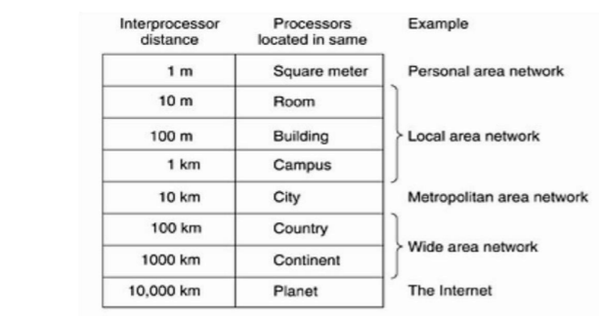
4.2. Scale
An alternative criterion for classifying networks is their scale.
The table classifies networks according to their scale.

Slide 12
4.2.1.Personal Area Networks
It communicate over the range of person.
Its coverage area of the network is within a meter.
Ex.Bluetooth

Slide 13
4.2.2. Local Area Networks
Local area networks, called LANs, are privately-owned networks within a single building or campus of up to a few kilometres in size.
They are widely used to connect personal computers and workstations in company offices and factories to share resources (e.g., printers) and exchange information.
LANs are distinguished by three characteristics: (1) size, (2) transmission technology (3) topology.
LANs are restricted in size. LANs use a transmission technology consisting of a cable to which all the machines are attached.
Various topologies are used for broadcast LANs.

Slide 14
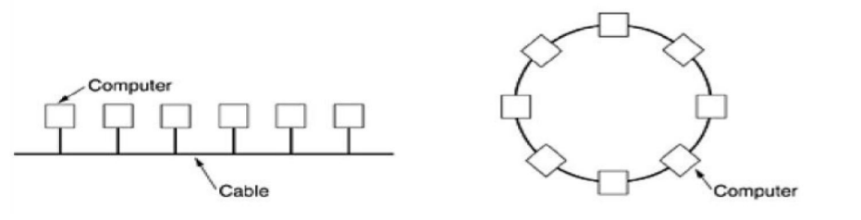
In a bus network, at any instant at most one machine is the master and is allowed to transmit. All other machines are required to refrain from sending. Eg: IEEE 802.3(Ethernet).
In the ring system each bit propagates around on its own, not waiting for the rest of the packet to which it belongs. Eg: IEEE 802.5 (the IBM token ring)

Slide 15
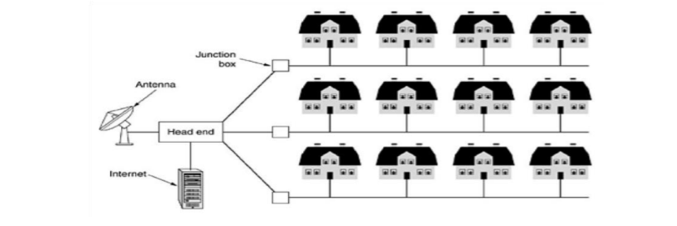
4.2.3 .Metropolitan Area Networks
A metropolitan area network, or MAN, covers a city like cable television network available in many cities

Slide 16
4.2.4. Wide Area Networks
A wide area network, or WAN,covers large geographical area, often a country or continent.
It contains a collection of machines intended for running user programs.
The hosts are connected by a communication subnet.
The hosts are owned by the customers, whereas the communication subnet is owned and operated by a telephone company or Internet service provider.
The job of the subnet is to carry messages from host to host.
In most wide area networks, the subnet consists of two distinct components: transmission lines and switching elements.

Slide 17
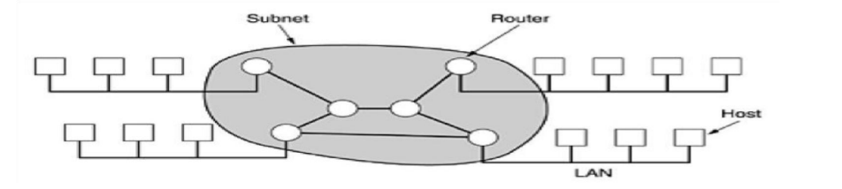
Transmission lines move bits between machines. They can be made of copper wire, optical fiber, or even radio links.
Switching elements are specialized computers that connect three or more transmission lines.
When data arrive on an incoming line, the switching element must choose an outgoing line on which to forward them. These switching computers are called router.

Slide 18
The collection of communication lines and routers that move packets from the source host to the destination host form the subnet.
When a packet is sent from one router to another via one or more intermediate routers, the packet is received at each intermediate router in its entirety, stored there until the required output line is free, and then forwarded.
This is called store-and-forward or packet-switched subnet.
If the packets are small and all the same size, they are called cells.
A process on some host has a message to be sent to a process on some other host, the sending host first cuts the message into packets, each one bearing its number in the sequence.
These packets are then injected into the network one at a time in quick succession.
The packets are transported individually over the network and deposited at the receiving host, where they are reassembled into the original message and delivered to the receiving process.

Slide 19
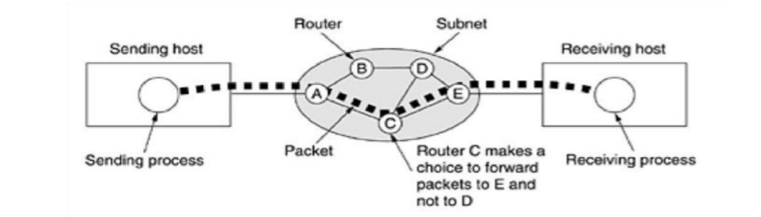
4.2.5 .Internetworks
The world collection of computer is called internetworks or internet.
Gateway: it is used to connection between two or more networks

Slide 20
5. Wireless Networks
Wireless networks can be divided into three main categories:
System interconnection- It is interconnecting the components of a computer using short-range radio.
Some short-range wireless networks called Bluetooth are used to connect these components without wires.
Wireless LANs are systems in which every computer has a radio modem and antenna with which it can communicate with other systems.
Wireless WANs.

Slide 21
6.Home Networks
Every device in the home is capable of communicating with every other device, and all of them will be accessible over the Internet.
Some categories are :
Computers (desktop PC).
Entertainment (TV, DVD).
Telecommunications (telephone, mobile telephone).
Appliances (microwave, refrigerator).
Telemetry (utility meter, smoke/burglar alarm). Home networking has different properties than other network types. These are:
The network and devices have to be easy to install.
The network and devices have to be fool proof in operation.
Low price is essential for success.
Security and reliability is very important.

Slide 22
NETWORK SOFTWARE
Protocol Hierarchies
Networks are organized as a stack of layers or levels, each one built upon the other.
The number of layers, the name of each layer, the contents of each layer, and the function of each layer differ from network to network.
The purpose of each layer is to offer certain services to the higher layers.

Slide 23
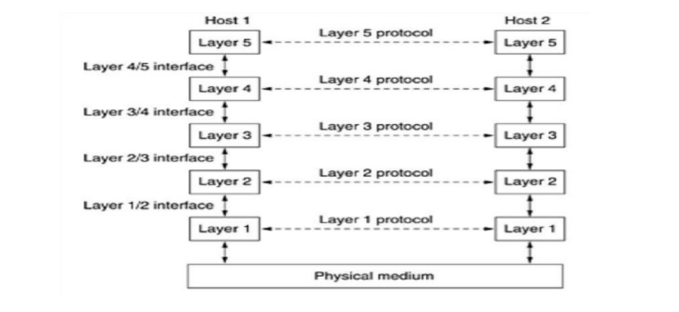
A five-layer network is:

Slide 24
The entities comprising the corresponding layers on different machines are called peers. The peers may be processes, hardware devices, or even human beings.
No data are directly transferred from layer n on one machine to layer n on another machine. Each layer passes data and control information to the layer immediately below it, until the lowest layer is reached.
Below layer 1 is the physical medium through which actual communication occurs.
A set of layers and protocols is called a network architecture. A list of protocols used by a certain system, one protocol per layer, is called a protocol stack.

Slide 25
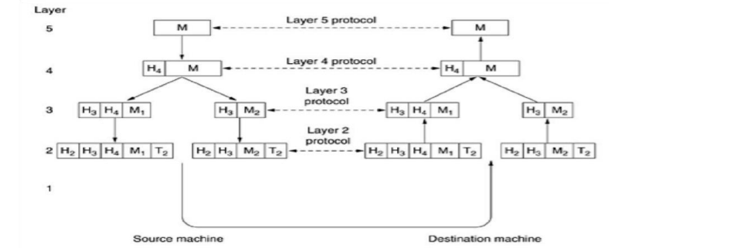

Slide 26
Connection-Oriented and Connectionless Services
Layers offer two different types of service to the layers above them: connection-oriented and connectionless.
Connection-oriented service first establishes a connection, uses the connection, and then releases the connection. eg. Telephone system.
Connectionless service is modelled after the postal system. Each message carries the full destination address, and each one is routed through the system independent of all the others.
Unreliable connectionless service is called datagram service, which does not return an acknowledgement to the sender.
In this service the sender transmits a single datagram containing a request; the reply contains the answer.

Slide 27
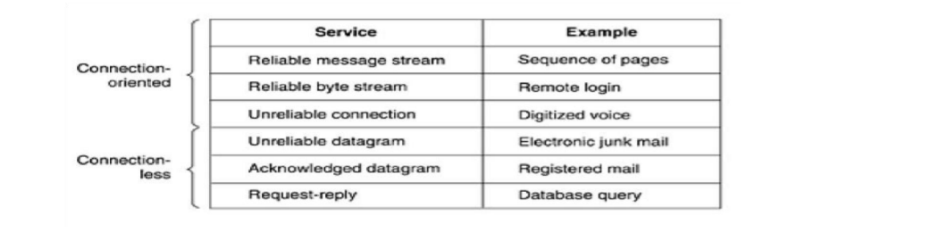

Slide 28
Service Primitives
A service is specified by a set of primitives available to a user process to access the service.
The primitives are normally system calls of an OS.
Some of the essential primitives:

Slide 29
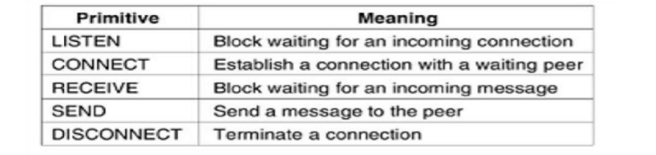

Slide 30
The server executes LISTEN to indicate that it is prepared to accept incoming connections. After executing the primitive, the server process is blocked until a request for connection appears.
The client process executes CONNECT to establish a connection with the server. The CONNECT call needs to specify who to connect to. The operating system sends a packet to the peer asking it to connect.
When the system sees that the packet is requesting a connection, it checks to see if there is a listener. If so, it does two things: unblocks the listener and sends back an acknowledgement. The arrival of this acknowledgement then releases the client.
The server executes RECEIVE to prepare to accept the first request. Then the client executes SEND to transmit its request followed by the execution of RECEIVE to get the reply.
The client use DISCONNECT to terminate the connection. When the server gets the packet, it also issues a DISCONNECT of its own, acknowledging the client and releasing the connection.

Slide 31
Relationship of Services and Protocols
A service is a set of primitives that a layer provides to the layer above it.
The service defines what operations the layer is prepared to perform on behalf of its users, but it says nothing at all about how these operations are implemented.
A service relates as an interface between two layers, with the lower layer being the service provider and the upper layer being the service user.
A protocol is a set of rules governing the format and meaning of the packets, or messages that are exchanged by the peer entities within a layer.
Services relate to the interfaces between layers whereas protocols relate to the packets sent between peer entities on different machines.

Slide 32
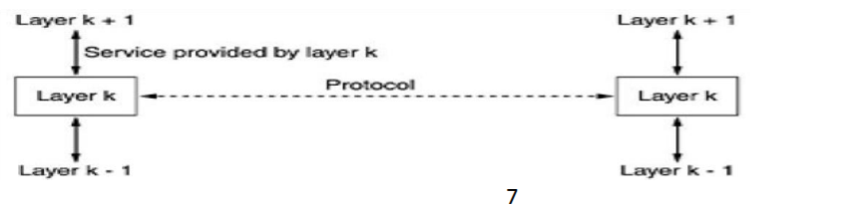

Slide 33
Reference Models
The OSI Reference Model
This model is based on a proposal developed by the International Standards Organization (ISO).
It is called the ISO OSI (Open Systems Interconnection) Reference Model because it deals with connecting open systems that is, systems that are open for communication with other systems.

Slide 34
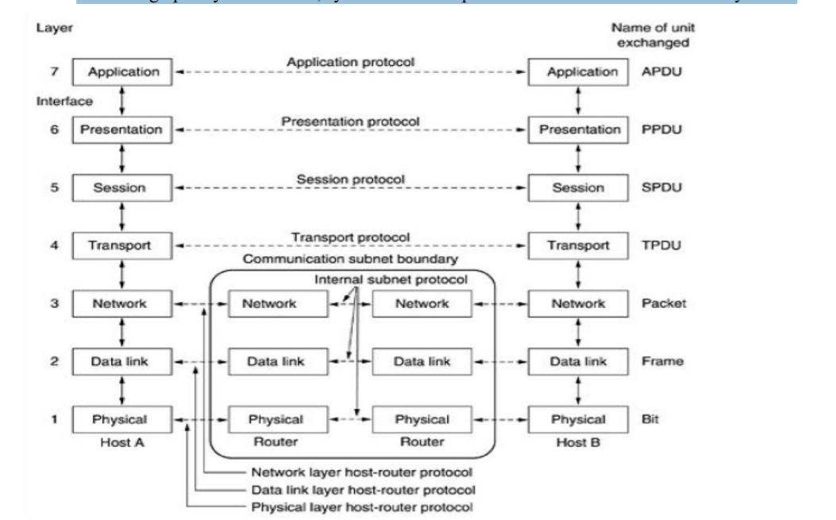

Slide 35
The Physical Layer
The physical layer is concerned with transmitting raw bits over a communication channel.
The components of the physical layer are:
• Cabling system components
• Adapters that connect media to physical interfaces
• Hub, repeater, and patch panel specifications
• Network Interface Card (NIC)

Slide 36
The Data Link Layer
The main task of the data link layer is to transform a raw transmission facility into a line that appears free of undetected transmission errors to the network layer.
It performs this task by the sender breaking up the input data into data frames and transmit the frames sequentially.
If the service is reliable, the receiver confirms correct receipt of each frame by sending back an acknowledgement frame.

Slide 37
This layer provides the following functions:
• Allows a device to access the network to send and receive messages
• Offers a physical address so a device’s data can be sent on the network
• Works with a device’s networking software when sending and receiving messages
Provides error-detection capability
The common networking components are :
• Network interface cards
• Ethernet and Token Ring switches
• Bridges

Slide 38
The Network Layer
The network layer controls the operation of the subnet.
A key design issue is determining how packets are routed from source to destination. The quality of service provided is also a network layer issue.
When a packet has to travel from one network to another to get to its destination, many problems can arise.
Network layer overcomes all these problems to allow heterogeneous networks to be interconnected

Slide 39
The Transport Layer
The basic function is to accept data from above, split it up into smaller units , pass these to the network layer, and ensure that the pieces all arrive correctly at the other end.
The transport layer also determines what type of service to provide to the session layer, and, to the users of the network.
The Session Layer
The session layer allows users on different machines to establish sessions between them.
Sessions offer various services like dialog control, token management, and synchronization.

Slide 40
The Presentation Layer
It is concerned with the syntax and semantics of the information transmitted.
The presentation layer manages abstract data structures and allows higher-level data structures (e.g., banking records), to be defined and exchanged.
The Application Layer
The application layer contains a variety of protocols that are commonly needed by users.eg: HTTP (HyperText Transfer Protocol), which is the basis for the World Wide Web.
When a browser wants a Web page, it sends the name of the page it wants to the server using HTTP. The server then sends the page back.
Other application protocols are used for file transfer, electronic mail, and network news.

Slide 41
The TCP/IP Reference Model
The ARPANET was a research network sponsored by U.S. Department of Defense with a major goal to connect multiple networks.
This architecture was later known as the TCP/IP Reference Model, after its two primary protocols. The relation between OSI and TCP/IP model is:

Slide 42
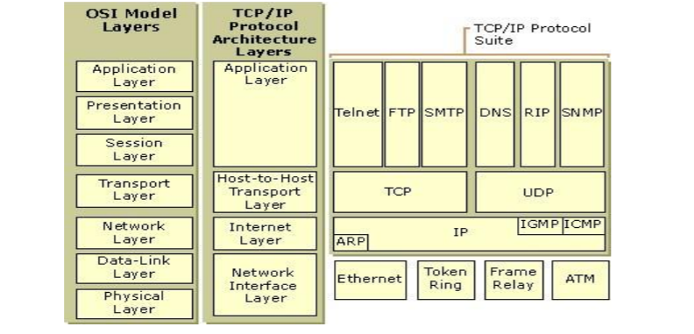

Slide 43
The Network Interface Layer
This is also called as Network Access Layer. This is the first layer of the four layer TCP/IP model.
Network Access layer defines details of how data is physically sent through the network, including how bits are electrically or optically signaled by hardware devices .
The layer is responsible for placing TCP/IP packets on the network medium and receiving TCP/IP packets off the network medium.
It is used to connect different network types like LAN technologies such as Ethernet and Token Ring.
The protocols included are Ethernet, Token Ring, FDDI, X.25, Frame Relay etc.

Slide 44
The Internet Layer
This layer permits hosts to inject packets into any network and have them travel independently to the destination.
They may even arrive in a different order than they were sent, in which higher layers rearrange them.
It defines an official packet format and protocol called IP (Internet Protocol).
The job of the internet layer is to deliver IP packets where they are supposed to go. Packet routing is clearly the major issue

Slide 45
The Internet layer is responsible for addressing, packaging, and routing functions. The core protocols of the Internet layer are IP, ARP, ICMP, and IGMP.
The Internet Protocol (IP) is a routable protocol responsible for IP addressing, routing, and the fragmentation and reassembly of packets.
The Address Resolution Protocol (ARP) is responsible for the resolution of the Internet layer address to the Network Interface layer address such as a hardware address.
The Internet Control Message Protocol (ICMP) is responsible for providing diagnostic functions and reporting errors due to the unsuccessful delivery of IP packets.
The Internet Group Management Protocol (IGMP) is responsible for the management of IP multicast groups.

Slide 46
The Transport Layer
The layer above the internet layer is called the transport layer. It is designed to allow peer entities on the source and destination hosts to carry on a conversation.
TCP (Transmission Control Protocol), is a reliable connection-oriented protocol that allows a byte stream originating on one machine to be delivered without error on any other machine in the internet.
It fragments the incoming byte stream into discrete messages and passes each one on to the internet layer.
At the destination, the receiving TCP process reassembles the received messages into the output stream.
UDP (User Datagram Protocol), is an unreliable, connectionless protocol for applications that do not want TCP's sequencing or flow control and wish to provide their own. The relation of IP, TCP, and UDP is:

Slide 47
The Application Layer
The Application layer provides applications the ability to access the services of the other layers and defines the protocols that applications use to exchange data.
The most widely-known Application layer protocols are those used for the exchange of user information:
• The Hypertext Transfer Protocol (HTTP) is used to transfer files that make up the Web pages of the World Wide Web.
• The File Transfer Protocol (FTP) is used for interactive file transfer.
• The Simple Mail Transfer Protocol (SMTP) is used for the transfer of mail messages and attachments.
• Telnet, a terminal emulation protocol, is used for logging on remotely to network hosts.

Slide 48
Example Networks
The ARPANET
The Internet is not a network, but a vast collection of different networks that use certain common protocols and provide certain common services.
US created a single defence research organization, ARPA, the Advanced Research Projects Agency – it had no scientists or laboratories but did its work by issuing grants and contracts to universities and companies.

Slide 49
NSFNET
In 1970s, NSF (the U.S. National Science Foundation) found the major impact of the ARPANET and designed a successor to the ARPANET that is open to all university research groups
NSF decided to build a backbone network to connect its six supercomputer centers, in San Diego, Boulder, Champaign, Pittsburgh, Ithaca, and Princeton
NSF also funded some regional networks that connected to the backbone to allow users at thousands of universities, research labs, libraries, and museums to access any of the supercomputers and to communicate with one another .
This complete network was called NSFNET

Slide 50
Internet
The number of networks, machines, and users connected to the ARPANET grew rapidly after TCP/IP became the only official protocol on January 1, 1983
When NSFNET and the ARPANET were interconnected, the growth became exponential. Many regional networks joined up, and connections were made to networks in Canada, Europe, and the Pacific
The glue that holds the Internet together is the TCP/IP reference model and TCP/IP protocol stack ▪ To be on the Internet - a machine is on the Internet if it runs the TCP/IP protocol stack, has an IP address, and can send IP packets to all the other machines on the Internet.
Up to 1990s, the Internet was largely populated by academic, government, and industrial researchers.
WWW (World Wide Web) changed all that and brought millions of new, non-academic users to the net

Slide 51
Ethernet
Internet and ATM are designed for wide area networking
The most popular LAN is Ethernet
Up to 256 machines could be attached to the system via transceivers screwed onto the cable.
A cable with multiple machines attached to it in parallel is called a multidrop cable
A computer first listened to the cable to see if someone else was already transmitting, the computer held back until the current transmission finished
Architecture of the original Ethernet.

Slide 52
